Slide 1
INTRODUCTION
Visual cryptography is a cryptographic technique that allows for secure image-based information sharing and authentication.
It is the process of verifying the identity of a user to grant access to a system or service securely.
User authentication using visual cryptography aims to enhance security by leveraging images to authenticate users.
Transparent Shares: Visual cryptography divides an image into two transparent shares, which individually reveal no information about the original image.
User Identity Verification: To authenticate a user, both shares are superimposed by the user, revealing the secret information.
Increased Security: Visual cryptography adds an extra layer of security to user authentication, making it difficult for unauthorized users to gain access.
User-Friendly: It can be more user-friendly compared to traditional password-based methods.

Slide 2
Motivation
Enhanced Security: Visual cryptography can provide an extra layer of security by encrypting data into multiple shares, making it challenging for unauthorized users to decipher the information. It ensures that sensitive data remains confidential.
Authentication: Visual cryptography can be used for authentication purposes, ensuring that only authorized individuals can access certain information or systems. It enables secure login processes and access control.
Human-Centric Security: Visual cryptography often involves the use of images or visual patterns, which are more user-friendly than complex passwords or cryptographic keys. This makes it easier for users to interact with the security system.
Multi-factor Authentication: Visual cryptography can be combined with other authentication methods to create a multi-factor authentication system, adding an extra layer of protection against unauthorized access.
Resilience to Attacks: Visual cryptography is resistant to various attacks, including brute force, because it relies on the combination of multiple shares to reveal the secret information. This makes it a robust security solution.

Slide 3
LITERATURE SURVEY
Sr no | Paper name and year | Author name | Disadvantages | Outcomes
1 | User Authentication using Visual Cryptography[2015] | Praveen Kumar. P Sabitha. S | The scheme requires a secure channel during the registration phase, which may not be suitable for all applications. Correlation between multiple authentication shares may lead to potential vulnerabilities. | The scheme offers a user authentication method that relies on the concept of visual cryptography, which is computationally less expensive compared to traditional cryptographic algorithms.It prevents brute force and dictionary attacks.

Slide 4
LITERATURE SURVEY
Sr no | Paper name and year | Author name | Disadvantages | Outcomes
2 | Development of Online Banking System Based on Secure Captcha Image Using Visual Cryptography [2023] | Lwin Lwin Oo | Implementing Captcha, Steganography and visual cryptography can increase system complexity and higher maintenance cost. There might be risk of security. | User password are converted into images for enhanced security with visual cryptography dividing the image. The use of BPSC steganography and captcha generation enhances system security.

Slide 5
LITERATURE SURVEY
Sr no | Paper name and year | Author name | disadvantages | Outcomes
3 | Secure E-Banking with Visual Cryptography[2022] | Yogesh Kore A. G. Patil - Aishwarya Hasbe Anuja Chougule - Ajinkya Sakale | - Limitations of the (2,2) Black and White Visual Cryptography Scheme: - Works only with black and white pictures. - Larger shares, requiring more storage. - Time-consuming encoding process | - Implemented Visual Cryptography and RSA for enhanced security. - Used image thresholding for secure password generation. - Additional authentication measures like thumb and face scanning. - Potential benefits for Core Banking Applications, reducing password theft issues.

Slide 6
LITERATURE SURVEY
Sr no | Paper name and year | Author name | disadvantages | Outcomes
4 | Design and implementation of a visual cryptography application [2020] | Petre Anghelescu, Marian Bodea | The lack of a decryption algorithm is a disadvantage, because if a sheet is lost, the information will not be able to be completely decrypted. | In this paper, an implementation for visual encryption strategies has been proposed. Input data could be based on black and white method.

Slide 7
LITERATURE SURVEY
Sr no | Paper name and year | Author name | disadvantages | Outcomes
5 | Image Based Authentication Using Visual Cryptography and Encryption Algorithm [2016] | Shreya Zarkar, Sayali vaidya | Visual cryptography often involves splitting an image into multiple shares. When these shares are combined, the original image is reconstructed. if even one of these shares is lost or corrupted, the original image cannot be recovered, making this method sensitive to data loss. | Image-based authentication can provide a higher level of security compared to traditional password-based methods. Visual cryptography and encryption add an extra layer of protection, making it more difficult for unauthorized users to gain access.

Slide 8
Problem Statements
The problem statement for User Authentication Using Visual Cryptography is to develop a secure and user-friendly authentication method that relies on dividing images into transparent shares.
These shares, when combined, should reveal secret information to authenticate users, thus enhancing security and simplifying the authentication process while addressing the challenges of traditional password-based methods.

Slide 9
Objective
To Improve security in user authentication processes by employing visual cryptography to make it more challenging for unauthorized access.
To Create a user-friendly authentication method.
To Protect Sensitive Information.
To control access to systems, documents, or secure areas in a secure and efficient manner.
To Develop a user authentication system that is both simple to use and adaptable to various applications and security needs.

Slide 10
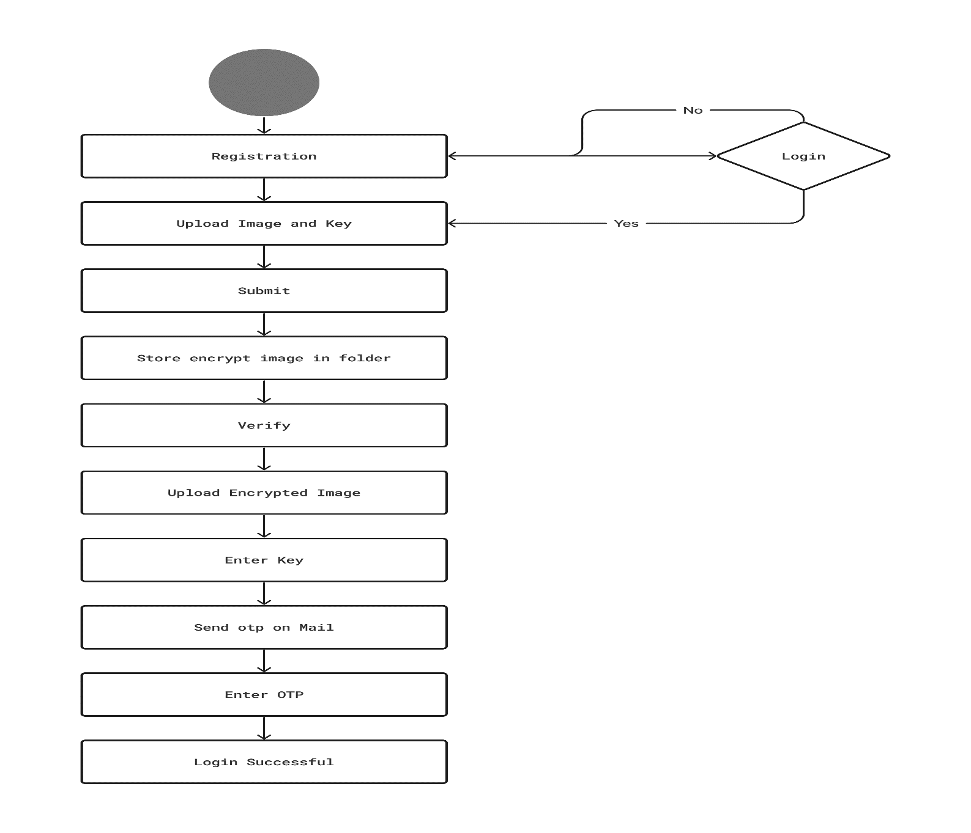
System Architecture

Slide 11
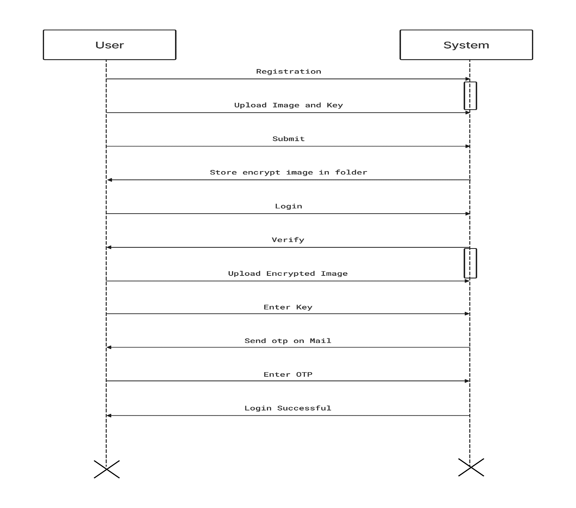
Sequence Diagram

Slide 12
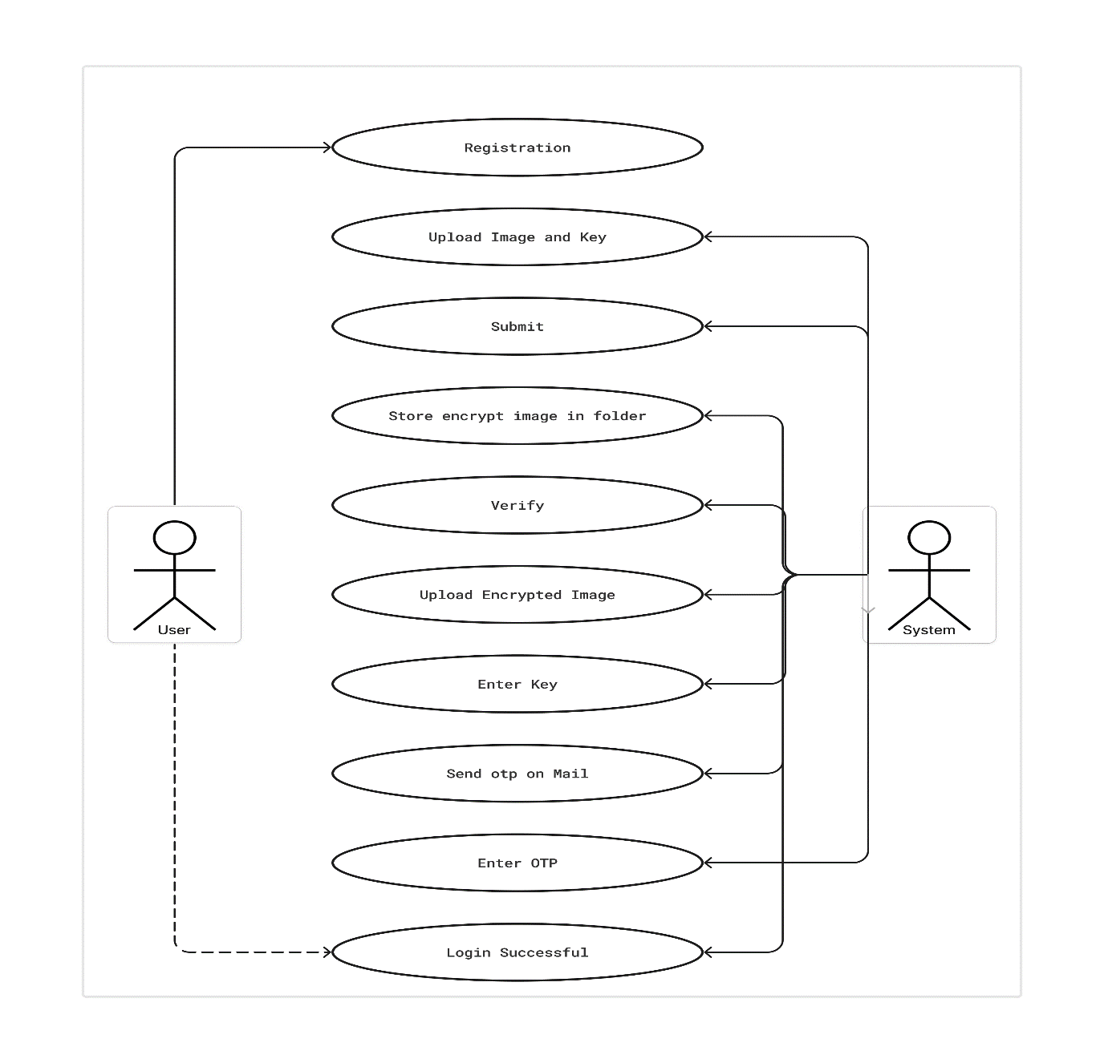
Use Case Diagram

Slide 13
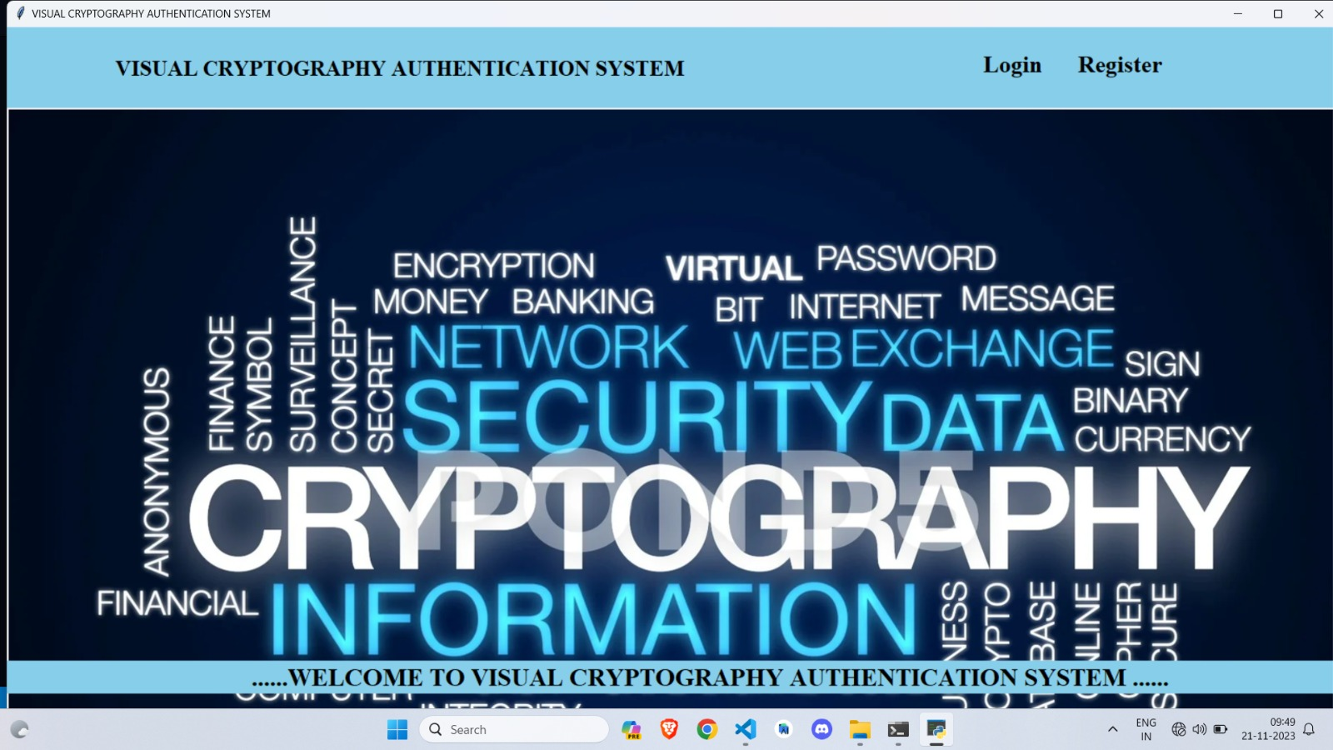
Modules
GUI :

Slide 14
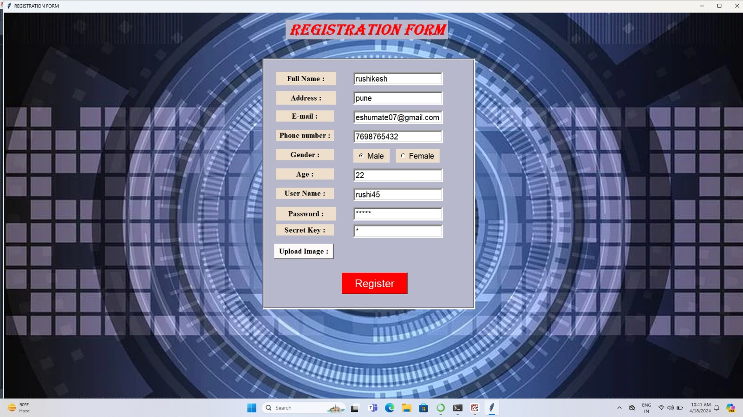
2.Register
Upload Image and Secret Key(AES Algorithm used for Encrypt Image).

Slide 15

3.Database Connectivity

Slide 16
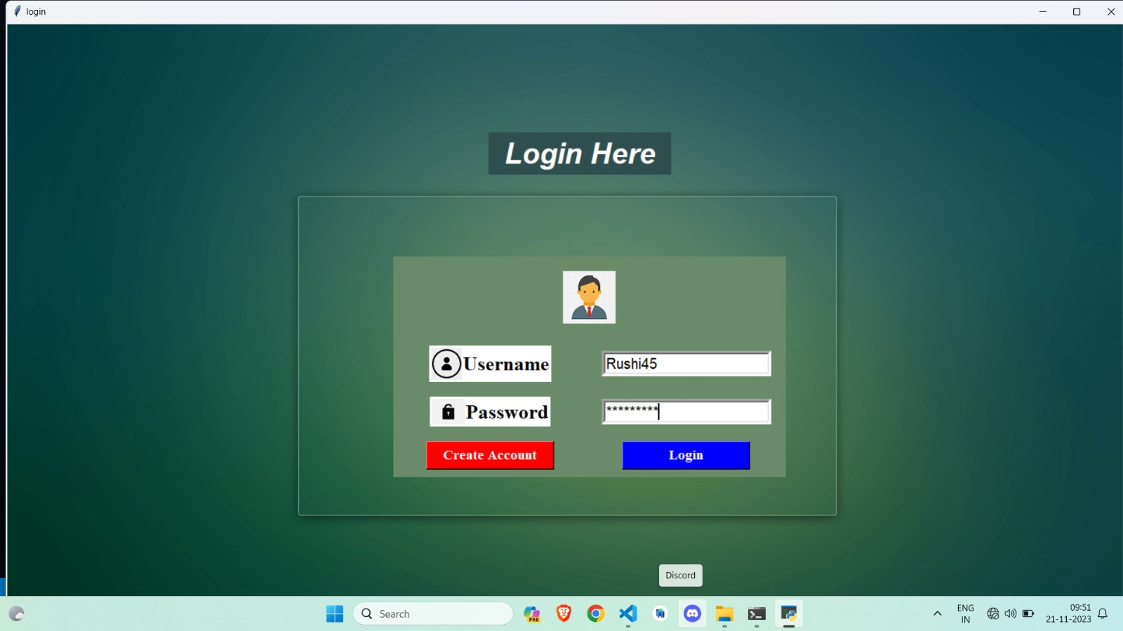
4.Login
Verify Username & Password(if match).

Slide 17
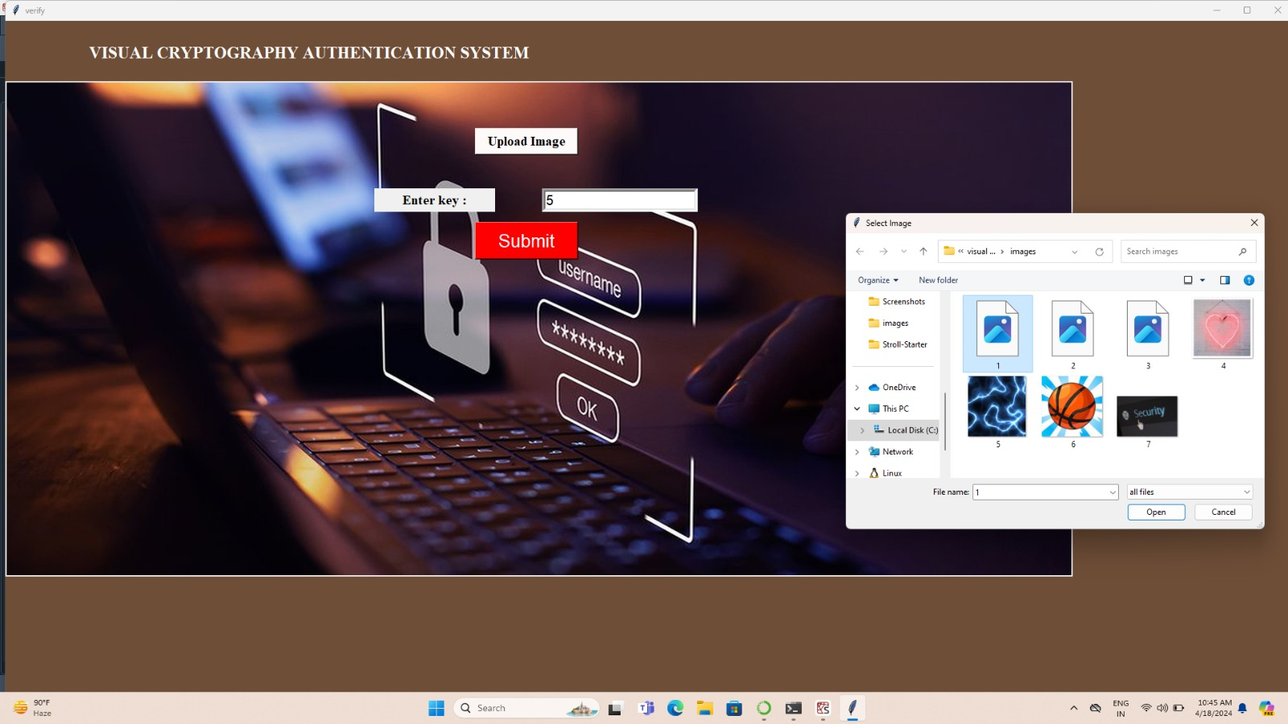
5.Upload Encrypted Image
Enter Your Secret key(if decrypt successfully).

Slide 18


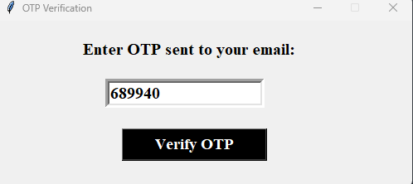
6.Send OTP On Email
Enter OTP.
.

Slide 19
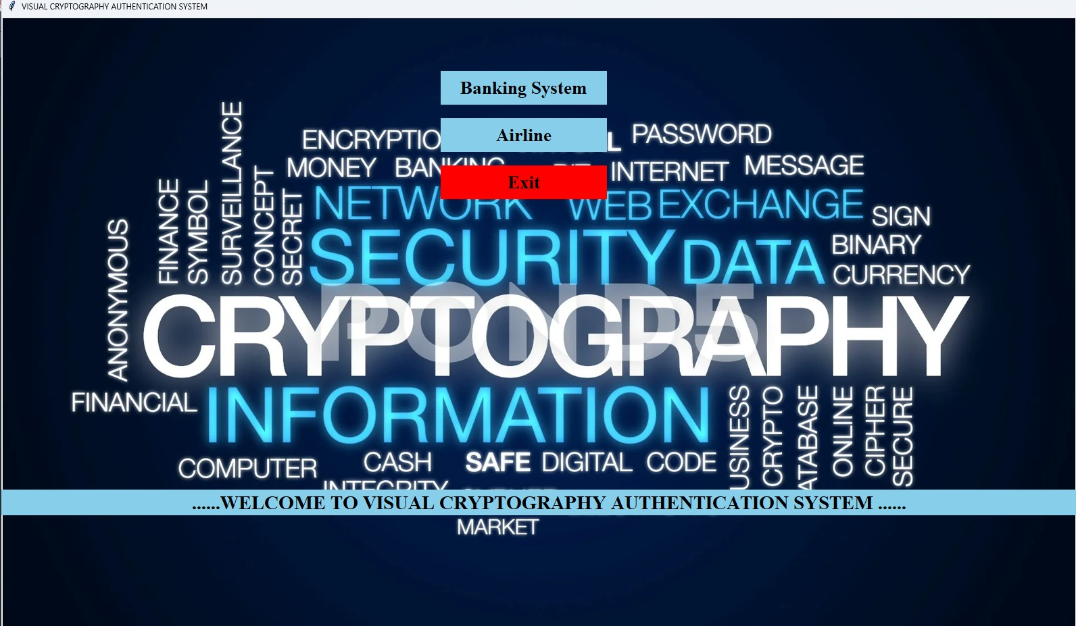
7. Successful login

Slide 20
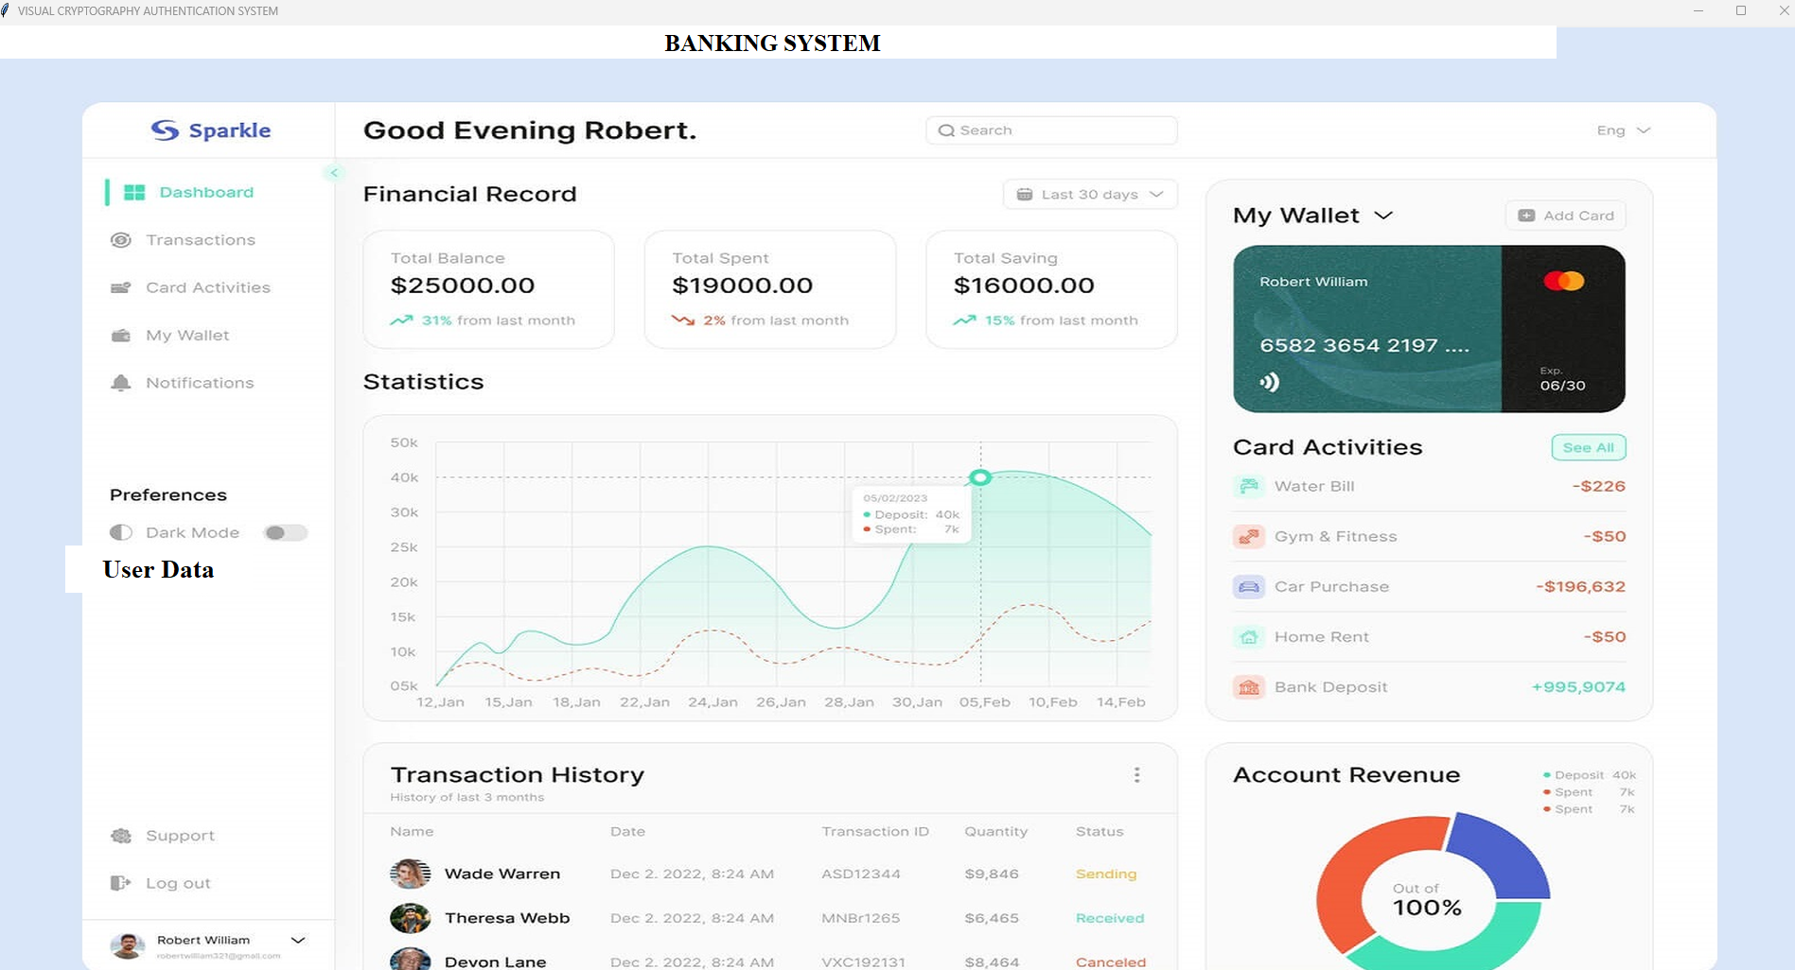
Banking System (Use Case)

Slide 21

Airline Online Booking System(Use Case)

Slide 22
Mathematical Model
Let S be the Whole system S= {I,P,O}
I-input
P-procedure
O-output
Input( I)
I={ Image }
Where,
Image -> Upload image at the time of registration
Procedure (P),
P={I, Using System perform operations , upload image set secret key and encrypt that image.}
Output(O)
O={System Decrypt encrypted image and send OTP on your Registered email id after that system gets successfully login}

Slide 23
Algorithm
The AES Encryption algorithm (also known as the Rijndael algorithm) is a symmetric block cipher algorithm with a block/chunk size of 128 bits. It converts these individual blocks using keys of 128, 192, and 256 bits. Once it encrypts these blocks, it joins them together to form the ciphertext.
Goals: To review the overall structure of AES and to focus particularly on the four steps used in each round of AES:
byte substitution
shift rows
mix columns
add round key

Slide 24
Software Requirements
Operating System: Windows 7 0r windows 10
IDE: VS code
Programming Language : Python
RAM : 8GB
Database : DB SQLITE 3
Key Board: Standard Windows Keyboard

Slide 25
Advantages
• Easy to implement and understand.
• No need for a secure channel to share the key.
• Resistant to computer attacks, as the shares are random and meaningless.
• No specialized software or hardware required.
• Can be used in various fields such as secure voting systems, banknotes, and secret sharing schemes.

Slide 26
Limitations
• Low embedding capacity, meaning it can only hide limited information.
• Sensitivity to noise and degradation, which can affect the quality of the reconstructed image.
• Limited resistance to attacks by humans with access to the shares.
• Requires precise alignment of shares to reveal the original message.

Slide 27
Applications
Secret Communication: Visual Cryptography and the AES algorithm enable secure transmission of confidential messages and sensitive information between parties, ensuring that the communication remains encrypted and protected from unauthorized access.
Copyright Protection: Integration of Visual Cryptography and the AES algorithm helps protect digital content from unauthorized replication and distribution, safeguarding the intellectual property rights of content creators and preventing piracy.
Document Authentication: Visual Cryptography combined with the AES algorithm ensures the authenticity and integrity of digital documents, allowing organizations to verify the legitimacy of important files and prevent tampering or unauthorized alterations.
Secret Data Storing: Visual Cryptography and the AES algorithm provide a secure method for storing sensitive data, ensuring that confidential information remains encrypted and accessible only to authorized users, thereby preventing unauthorized access and data breaches.

Slide 28
Conclusion
The visual cryptography system will provide a highly secure and user-friendly solution for data protection in multiple domains, ensuring privacy and preventing unauthorized access to sensitive information.

Slide 29
REFERENCES
[1] M. Naor and A. Shamir,” Visual Cryptography, Advances in Cryptography -EUROCRYPT’94, Lecture Notes in Computer Science 950, 1995, pp.1-12.
[2] Shamir,” How to Share a Secret,” Communication ACM, vol. 22, 1979, pp. 612-613.
[3] G. R. Blakley,” Safeguarding Cryptographic Keys,” Proceedings of AFIPS Conference, vol. 48, 1970, pp. 313-317.
[4] Menezes, P. Van Oorschot and S. Vanstone,” Handbook of Applied Cryptography,” CRC Press, Boca Raton, FL, 1997.
[5] Borchert,” Segment Based Visual Cryptography,” WSI Press, Germany, 2007.
[6] W-Q Yan, D. Jin and M. S. Kanakanahalli,” Visual Cryptography for Print and Scan Applications,” IEEE Transactions, ISCAS-2004, pp. 572-575.
[7] T. Monoth and A. P. Babu,” Recursive Visual Cryptography Using Random Basis Column Pixel Expansion,” in Proceedings of IEEE International Conference on Information Technology, 2007, pp. 41-43.
.

Slide 30
REFERENCES
[8] H. J. Kim, V. Sachnev, S. J. Choi and S. Xiang,” An Innocuous Visual Cryptography Scheme,” in Proceedings of IEEE-8 th International Workshop on Image Analysis for Multimedia Interactive Services, 2007.
[9] C. Blundo and A. De Santis,” On the contrast in Visual Cryptography Schemes,” in Journal on Cryptography, vol. 12, 1999, pp. 261-289.
[10] P. A. Eisen and D. R. Stinson,” Threshold Visual Cryptography with specified Whiteness Levels of Reconstructed Pixels,” Designs, Codes,
[11] Mohamed, A. A., & Madian, A. H. (2010, December). A Modified Rijndael Algorithm and its Implementation using FPGA. In Electronics, Circuits,
[12] Cole, Eric, and Ronald D. Krutz. Hiding in plain sight: Steganography and the art of covert communication. John Wiley & Sons, Inc., 2003.
[13] Suneetha, B., CH HIMA BINDU, and S. SARATH CHANDRA. “Secured data transmission based video steganography.” IEEE International Journal of Mechanical and Production Engineering (IJMPE) ISSN No.: 2315 4489.
[14] Naor, Moni, and Adi Shamir. “Visual cryptography.” Advances in Cryptology—EUROCRYPT'94. Springer Berlin/Heidelberg, 1995
.

Slide 31
THANK
YOU

